Slide 1

6.1 Introduction to OO
We can view the world as consisting of a set of objects with properties
For example, consider the activity of watching TV:
You want to change channel
You take the remote control and push a button
The TV changes channel
The remote control is a physical object with certain properties such as colour, weight, size etc.
The remote control can also perform a task – it can do something – it sends messages to the TV when the buttons are pressed
We do not need to know exactly how the remote control sends messages to the TV in order to use it – we need only know what we want to do and what buttons to press to achieve our goal
The buttons are an interface to the remote control and once we understand the interface we can use the remote control to perform a task for us
The TV is also a physical object with properties
When the TV receives a message from the remote control it changes channel as required
1
18/10/2020
Notes:
1

Slide 2
6.1 Introduction to OO
We can make two complicated devices interact to perform a complex activity without understanding the internal workings of
either of them.
We form abstractions of objects in order to allow
us to use them – e.g., if you went to a TV shop to
buy a new TV you would not have much difficulty
in using a different type of remote control to test a different brand of TV
We apply a similar process when developing Object Oriented software.
Determine the objects that make up the system.
Carefully create abstractions of these objects and separate their internal implementation from their external behaviour
1
18/10/2020
Notes:
1

Slide 3
6.1 Introduction to OO
We can think of objects as having
A name
Properties (or attributes) associated with it
Messages that it can understand
Examples
A tennis ball, a helicopter, a tree etc.
A number, a word, an image etc.
When an object receives a message it will typically
Take some action
and/or
Change its properties
1
18/10/2020
Notes:
1

Slide 4
6.1 Introduction to OO
Python provides a way of forming an abstraction of an object by encapsulating properties and messages into a single concept
We call the set of properties and messages members of the class
A class is an abstract concept whereas an object is a concrete entity
Example: the concept of a car is a class, but a yellow taxi with a diesel engine is a subclass, while 191 D 1234 is an object.
a class
1
18/10/2020
Notes:
1

Slide 5
6.1 Introduction to OO
When designing a class think about the objects that will be created from the class type.
What things does the object know about itself?
This will determine the state of the object
Things an object knows about itself are called instance variables
What are the things the object does?
This will determine the behaviour of the object
The things an object can do are called methods
1
18/10/2020
Notes:
1

Slide 6

6.2 Python Classes
Python Classes
We can think of classes as providing a blue-print for creating objects.
A class specifies the instance variables and methods that are associated together to define a type of object.
OO Programming involves creating objects and then having those objects interact with each other to solve a problem.
Objects interact with each other through message
passing
1
18/10/2020
Notes:
1

Slide 7
6.2 Python Classes
Message Passing
Message passing occurs when a method of one object calls a method of another
Object A
Object B
Method A1
Method B1
calls
1
18/10/2020
Notes:
1

Slide 8
6.2 Python Classes
Encapsulation
Information hiding
Some member variables remain private / hidden from view
Access to certain class members is restricted
An object will present an interface to other objects to allow interaction
1
18/10/2020
Notes:
1

Slide 9
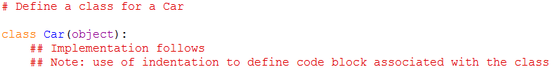
6.2 Python Classes
Defining Python Classes
We use the class keyword to define a class.
What instance variables can we define?
What behaviours can we define?
1
18/10/2020
Notes:
1

Slide 10
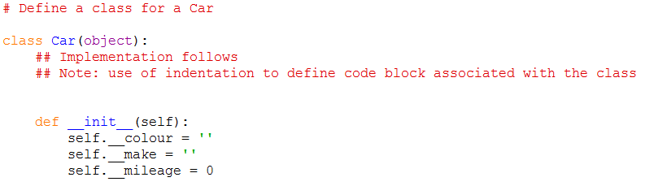
6.2 Python Classes
Defining Python Classes
Private instance variables of a class begin with two underscore characters (e.g., __colour ) and cannot be directly accessed
We will create special methods to access private instance variables
Private instance variables are initialized in a special method named __init__
InPython, functions serving as class methods must have an extra first parameter, by convention named self .
1
18/10/2020
Notes:
1

Slide 11
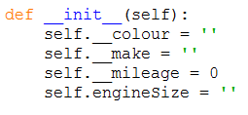
6.2 Python Classes
Defining Python Classes
If we do not want to keep the instance variables hidden we do not prepend with the underscore characters
1
18/10/2020
Notes:
1

Slide 12
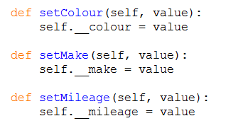
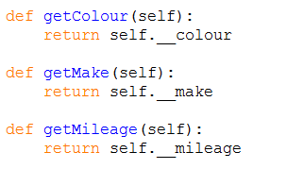
6.2 Python Classes
Defining Python Classes
We need someway to access the private instance variables
Use setter and getter methods
1
18/10/2020
Notes:
1

Slide 13
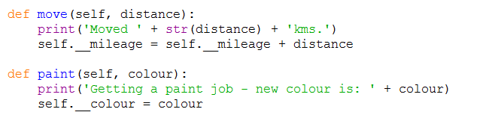
6.2 Python Classes
Defining Python Classes
Let’s add some behaviour
1
18/10/2020
Notes:
1

Slide 14
6.2 Python Classes
Defining Python Classes
Recall the class definition is like a blueprint
We would now like to use this blueprint to create some Car objects
First save our class definition as car.py
We will create a new program file called carApp.py
Object Instantiation
1
18/10/2020
Notes:
1

Slide 15
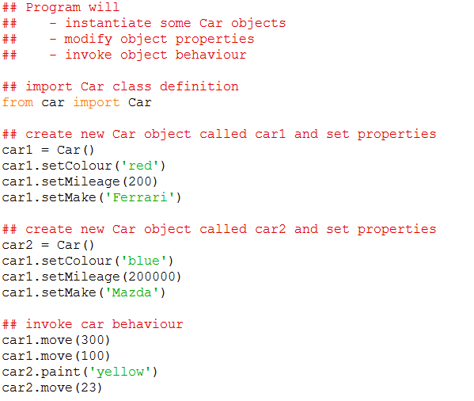
6.2 Python Classes
Defining Python Classes
Note: the __init__ method is implicitly called when an object is created.
carApp.py
1
Programming for BIG Data
18/10/2020
Notes:
1

Slide 16
6.3 Inheritance
Inheritance
This is the ability of a class to inherit members of a class as part of its own definition.
The inheriting class is called the subclass
The class inherited from is called the superclass
Car
Electric Car
Petrol Car
1
Programming for BIG Data
18/10/2020
Notes:
1

Slide 17
6.3 Inheritance
Inheritance
Inheritance in OO programming is the ability of a subclass to inherit members of a superclass as part of its own definition
Car
Electric Car
Petrol Car
1
18/10/2020
Notes:
1

Slide 18
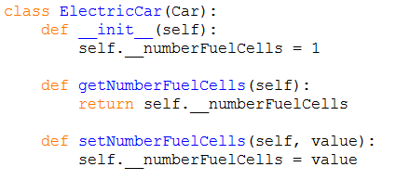
6.3 Inheritance
Inheritance
We define a subclass in the following way:
Class we are inheriting from
1
18/10/2020
Notes:
1

Slide 19
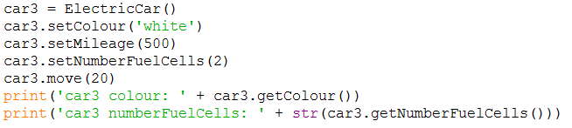
6.3 Inheritance
Inheritance
We can create a new ElectricCar and use the member elements from the Car superclass:
1
18/10/2020
Notes:
<number>

Slide 20
6.3 Summary
OO Programming
Python Classes
Inheritance
?
1
18/10/2020
Notes:
<number>

